Slide 1

Bankruptcy Prediction: Leveraging Data for Business Resilience
Predicting bankruptcy is crucial. It helps businesses become more resilient.

Slide 2
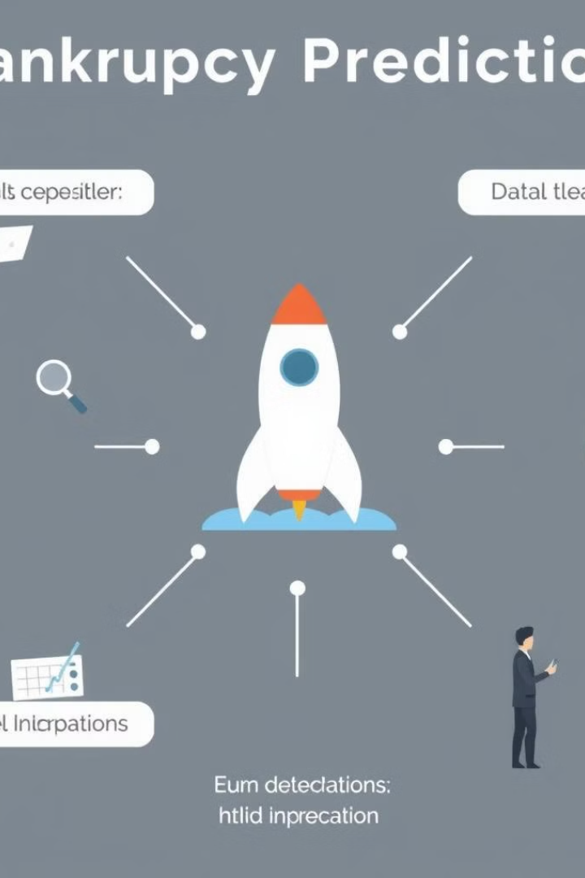
Introduction to Bankruptcy Prediction
1
Financial Distress
2
Data Analysis
Early warning signs of financial trouble.
Analyzing key financial ratios and trends.
3
Predictive Modeling
Building models to forecast bankruptcy risk.

Slide 3
Features of Bankruptcy Prediction Models
Net Income to Stockholder Equity
Borrowing dependency
Persistent EPS in the Last Four Seasons
Net profit before tax Paid in capital
Liability to Equity
Degree of Financial Leverage
Net Value Per Share A
Per Share Net profit before tax
Net worth Assets
Interest Expense Ratio
Net Value Per Share B
Non industry income and revenue
Debt ratio
ROAC before interest and depreciation before interest
Interest Coverage Ratio

Slide 4
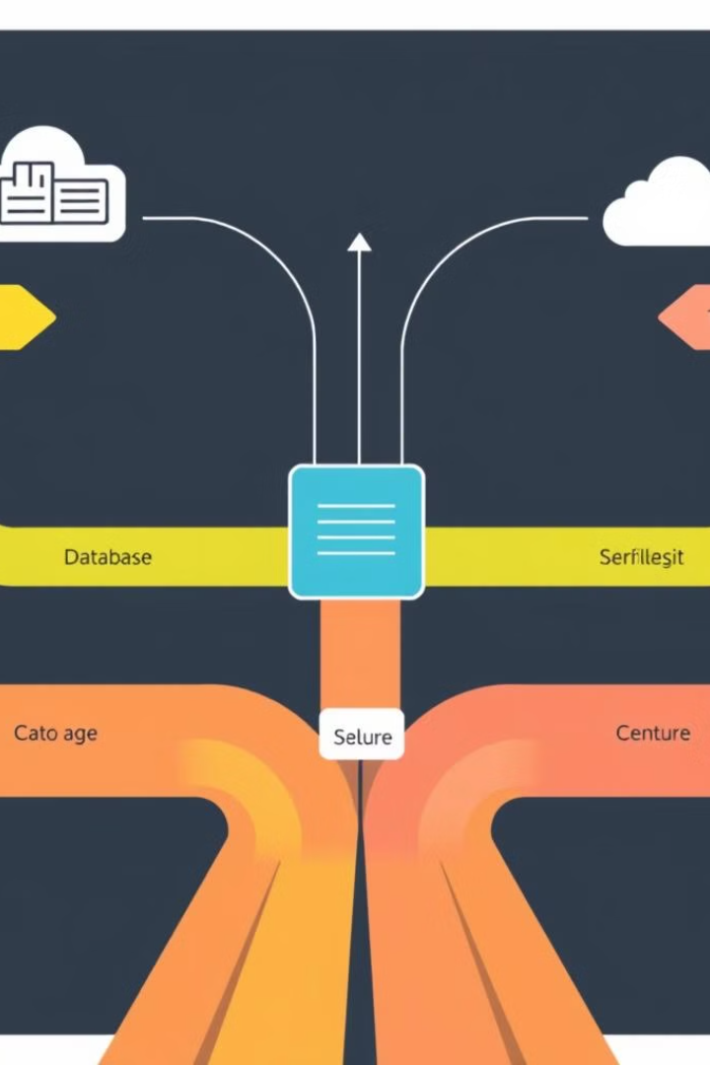
Models:
Random Forest Classification
XG Boost

Slide 5
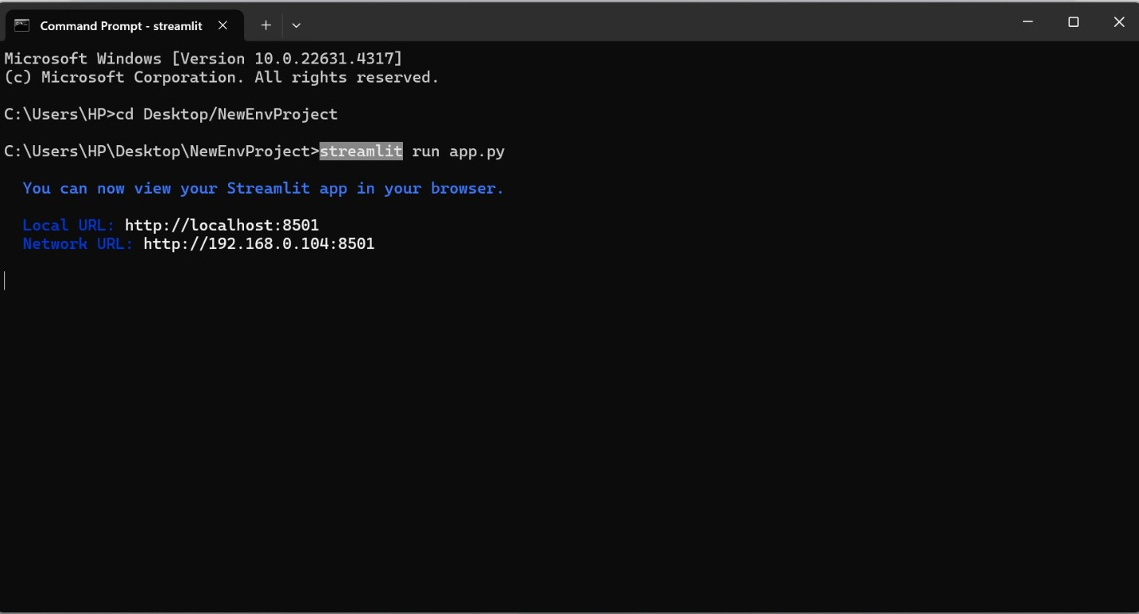
Deployment:

Slide 6
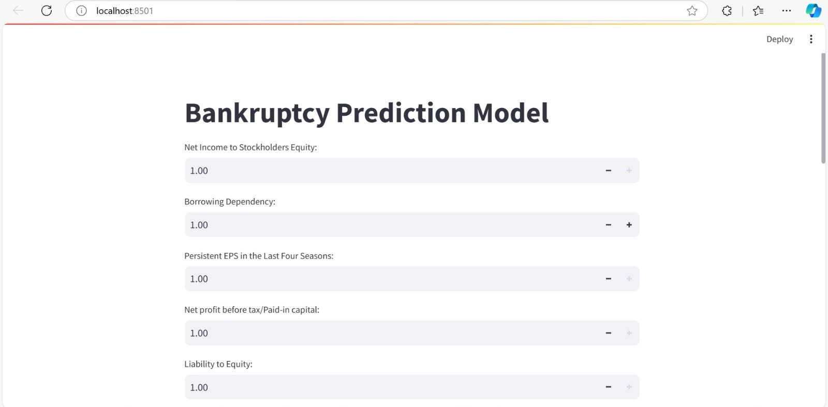

Slide 7
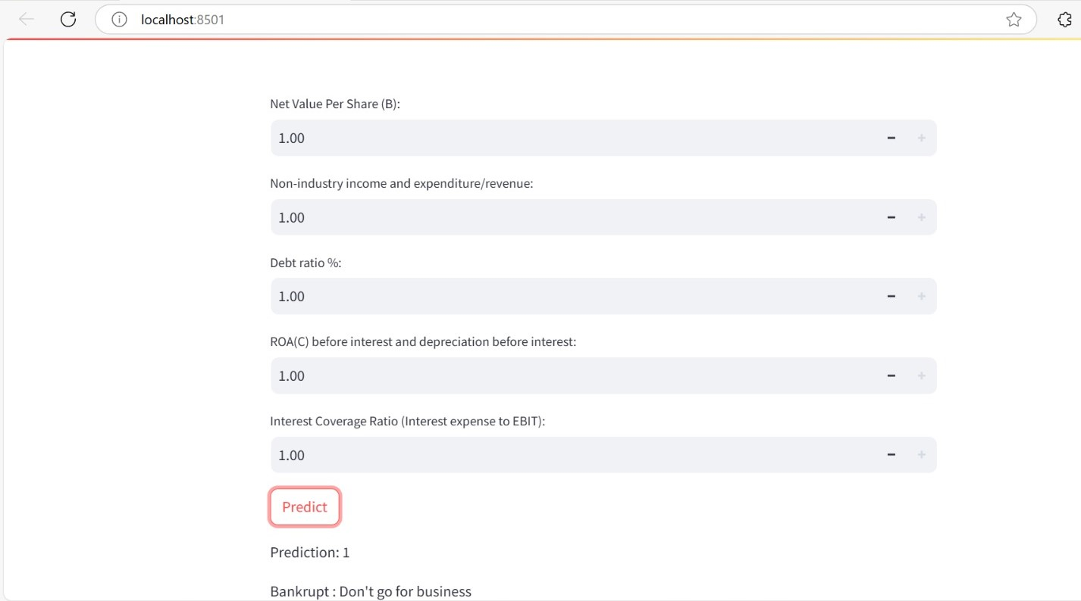

Slide 8




Conclusion and Considerations
Fairness
Transparency
Accountability
Avoiding bias in models.
Explainable AI models.
Responsibility for predictions.
0 - No Bankruptcy (Safe): This outcome indicates that, based on the input data and the model's predictions, the company is likely to remain financially stable and is not expected to face bankruptcy in the near future. It suggests that the financial indicators are within acceptable limits, implying good financial health.
1 - At Risk (Not Safe): This outcome signifies that the company shows signs of financial distress and may be at risk of bankruptcy. The model has identified certain financial factors or patterns that signal potential instability, requiring closer monitoring or corrective measures.
The prediction model provides valuable insights into a company allowing stakeholders to make informed decisions. However, while the model predicts potential outcomes, it's important to consider external factors and regular updates to ensure accuracy in changing market conditions.

